Slide 1

Off-Line Signature Recognition

Slide 2
Flow Chart of the Project
Signature Acquisition
Feature Extraction
Testing
Preprocessing
Verification

Slide 3
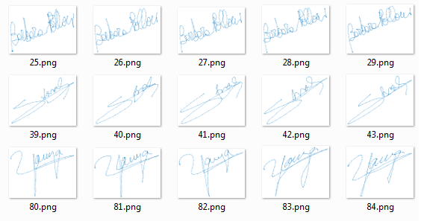
Signatures are scanned, resulting in an average image size of 256*256 pixels.
Signature Acquisition
Class 2
Class 1
Class 3

Slide 4
Pre-Processing
Grayscale Conversion Image should be converted into a grayscale image.
Binarization Removing background so that the image is black & white.
Thinning Reduces a connected region in the image to a smaller size and minimum cross-section.
Fitting Boundary Box Crop image to the size of the signature so that unnecessary areas are removed.
Normalization
Signatures are scaled to size 256 pixels × 256 pixels.

Slide 5
Feature Extraction
Kurtosis
A measure of flatness of distribution.
Skewness
A measure of asymmetry of distribution.
Area
Actual number of pixels in the region.
Centroid
Horizontal and vertical centers of gravity of the signature.
Eccentricity
Ratio of the distance between the foci of the ellipse and its major axis length.
horizontal projection & vertical projection.

Slide 6
Cont’d
Randon
Projection of the image intensity along a radial line oriented at (theta=0:45:135) and then calculate Hu's Seven Moments Invariant for every Angle.
Hu's Seven Moments Invariant
Simple properties of the image which are found via image moments include area (or total intensity), its centroid, and information about its orientation.
.
Orientation
The angle (in degrees) between the x-axis and the major axis of the ellips.

Slide 7
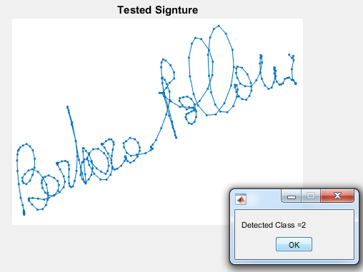
Verification
26 signatures of 3 individual are used in training and 5 signature in testing.
A competitive network will be used to classify these signature and we have achieved 85-100% efficiency for various test data’s.

